Slide 1

Pennsylvania Emergency
Management Agency
Presentation on the
911 Combined Report Overview
and
2023 911 Program Guidance Overview

Slide 2
Today’s Agenda
Introduction of the PEMA Team
PSAP Portal Plan update
15% Schedule B, 2022 expenditures
2022 15% Grant Agreements
Webtool, Combined Report review
2023 911 Program Guidance
Question and Answer

Slide 3
Combined Report Completion
Critical Deadline
APRIL 15, 2023

Slide 4
Pennsylvania Emergency
Management Agency
Presentation
on
911 Combined Report Overview

Slide 5
2022 Combined Report
The Combined Report consists of the following sections:
Uniform 9-1-1 Fund Activity
Schedule A – Formula Funding Expenditures (83%)
Schedule B – Statewide Interconnectivity Funding Expenditures (15%)
Schedule C – Reserves & Deferrals
5. Annual Report – 1/1/2022 – 12/31/2022
Uniform Fund Activity
Other Activity
Call Volume Information
Call Volume/CAD Event File Manager
County Controller’s Certification

Slide 6
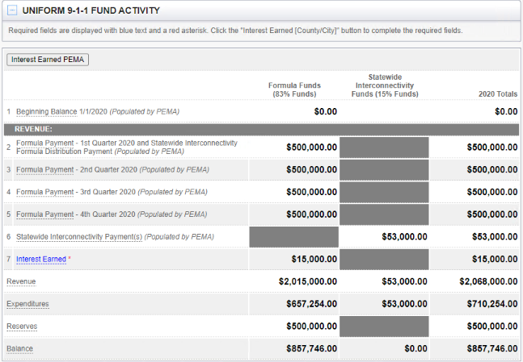
2022 Combined Report
Note:
Formula Funds (83%) and
Statewide Interconnectivity Funds (15%)
disbursements and expenditures are recorded and uploaded in their respective columns and
combined in the ‘Total’ column of the report

Slide 7
Helpful Hints and Tools
Opening multiple Combined Reports at one time.
Opening multiple years at one time.
Cut and paste from one to another.
Cut and paste from word, excel, etc. into the CR.
Sort multiple fields (headers.)
Search by vendor, amount, location, etc.
Export reports for multiple uses.

Slide 8
Helpful Hints and Tools
Be sure to mark the check box for uploaded documents.
Uploaded documents can be selected for multiple expenses, but you must mark the check box every time.
Uploading invoices to Schedule A is NOT the same as is done in Schedule B. See Instructions.
Refer to previously uploaded multi-year contracts, rental agreements... No need to upload them again.

Slide 9
Expense Documentation Guidance
Supporting Documentation
Supporting Documentation
Expenses must meet the PA 911 Program 2022 Eligibility Criteria.
Provide adequate information to demonstrate eligibility.
Provide adequate details in the “Item Description” field is critical.
Upload any documentation to support eligibility.
PEMA will contact the PSAP for documentation when eligibility is not clear.
Schedule B requires invoices as documentation.
Formal Audit will still require invoices especially if you use spreadsheets.

Slide 10
Expense Documentation Guidance
Supporting Documentation
Formal Audit will still require invoices especially if you use spreadsheets.
Uploads should be specific to the expense line items or easily identified.
If using spreadsheets, county documents, etc. the expense must be clearly noted.
Single upload for single expense referencing the correct item is best.
Do not upload information not specific to 911 such as other department’s data.
Multiple expenses can be connected to one document. Be sure to select the box.

Slide 11
Section 1: Uniform 911 Fund Activity
Summarizes 2022 revenue, expenditure, and balance information related to the 911 surcharge.
Clarifications/Tips:
Balance Formula Funds’ reflects available 9-1-1 surcharge revenue.
Balance CAN NOT be negative.
If Balance is negative:
Reduce Reserves
Move costs from Schedule A to “Other Activity” section.
PSAP’S Responsibility:
Complete line 7 Interest earned

Slide 12
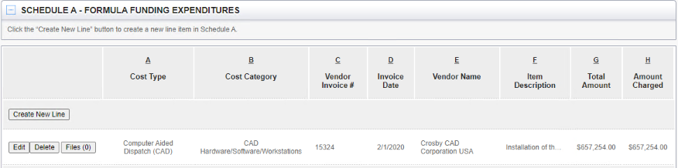
Section 2: Schedule A
Report costs funded by formula-based funds (83% funds) in 2022.
Costs are summarized by Cost Type, Cost Category, and Vendor (sortable).
It is strongly recommended to update Schedule A routinely.
Referring to previous years’ reports and PEMA reviews is vital.
Copy/Paste option can save a great deal of time when doing entries.
‘Ctrl F’ is a GREAT TOOL for searching!!!!!

Slide 13

Schedule A
Uploading Expenditures (files)
Uploading Expenditures (files)
Please do not combine uploads. Separating them by vendor works best.
It is best if you name your uploaded invoices by putting the Vendor name first.
They will appear alphabetical in the list and are found quickly.
Please do not upload scanned excel docs/reports. They can not be searched. PEMA will accept spreadsheet files (not scanned spreadsheets), if selected during the audit, the PSAP will be required to produce invoices. Spreadsheets not accepted during the audits.
It is essential that the boxes are checked. The report will need to be returned if this is not done.
You can check the same upload multiple times (excel spreadsheets, monthly invoices, contracts…)
Check the Box to ensure the corresponding detail is connected.

Slide 14
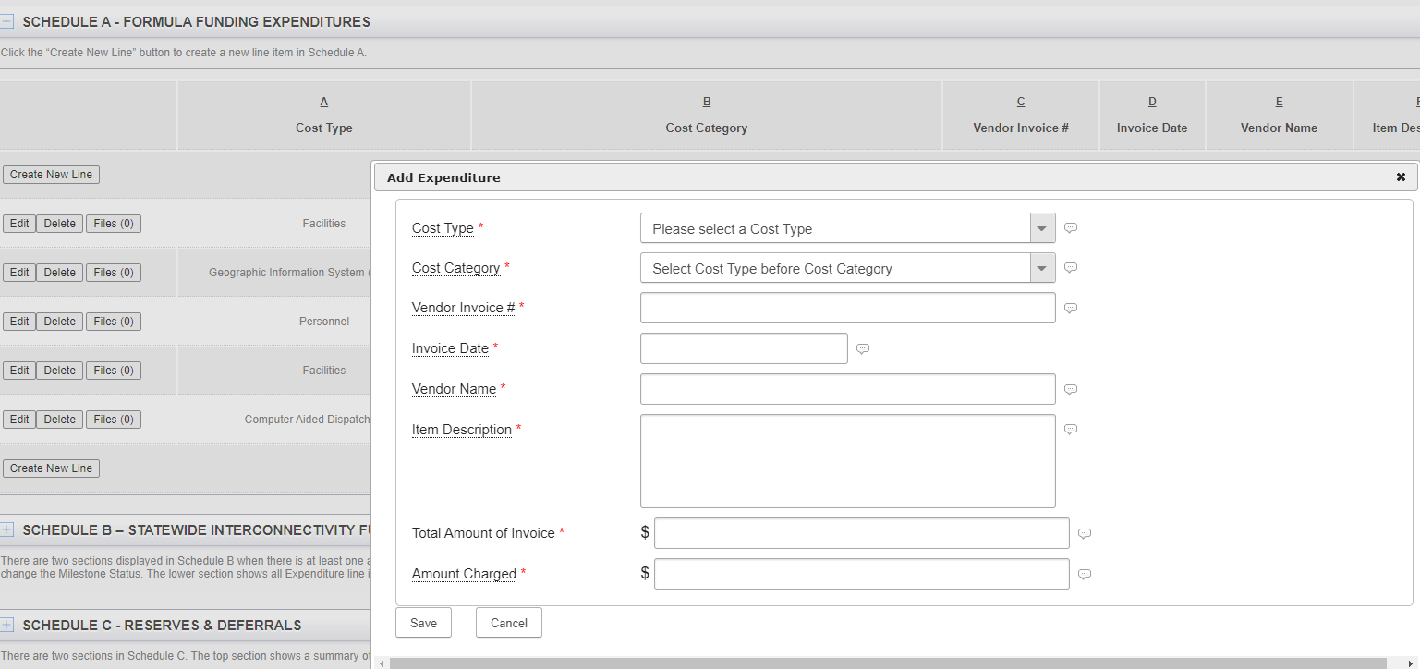
Schedule A: Creating an Expenditure
Select ‘Create New line’ and Complete the Form
Click ‘Save’

Slide 15
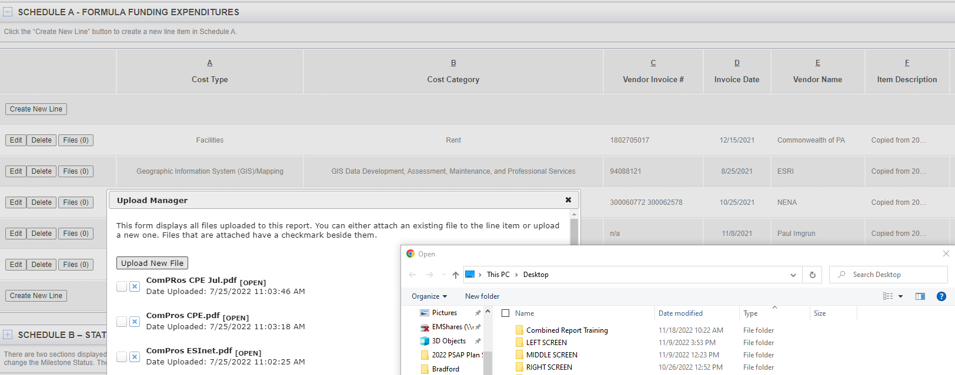
Schedule A: Uploading a File
After creating the expenditure, the line will appear, click on File (0).
Click the upload new file or select an already uploaded file.
Upload the file if not there - name it so it is easy to find.

Slide 16
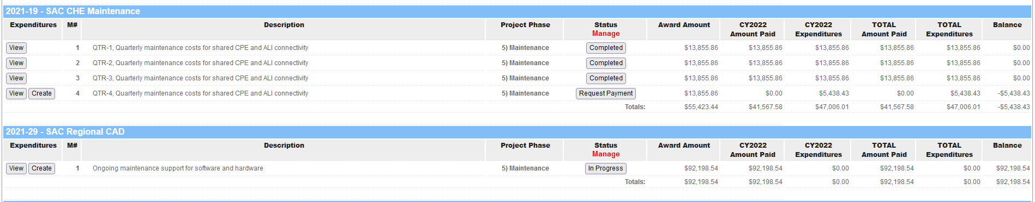
Schedule B - Overview
Statewide Interconnectivity Grant Awards
Project information (Milestones, Award Amount, Amount Paid) is pre-populated.
Project balance can NOT be negative
Use your project budget as a guide.
Contact the PEMA Office with any questions or concerns.
Monitor ‘Schedule B’ regularly
Starting with 2023, ‘Schedule B’ will be done quarterly only.

Slide 17
Schedule B
PSAP’s Responsibility
Report project costs in a timely manner.
Update project status. Do not mark a project compete unless all expenditures are uploaded to the Milestone.
Invoices are required for all expenditures in Schedule B (Note: Excel spreadsheets are not acceptable documentation)
Upload expenditure to the correct project, milestone, and appropriate year
Upload invoice for each expenditure.

Slide 18
Schedule B
PSAP’s Responsibility
Please ensure to mark the correct box attaching the invoice to the expenditure.
Do not enter any data for 2023 into Schedule B.
Request advance payments or reimbursements
Notify PEMA of project completion
PEMA will communicate with County for potential Return of Funds (ROF) should Milestone funds remain after Project is completed.

Slide 19
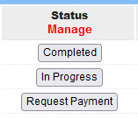
Project Status Selection

Slide 20
Project Status Selection
Completed: This status is used to indicate all expenditures are uploaded to the Milestone. Selecting “Complete” will lock the County from entering any additional expenditures to the Milestone
Request Payment: This status indicates the County desires a disbursement of funds associated with the award amount to support expenditures for the associated Milestone.
In Progress: This status indicates the County requested funds and preparing to upload expenditures to the Milestone.
Completed: This status is used to indicate all expenditures are uploaded to the Milestone. Selecting “Complete” will lock the County from entering any additional expenditures to the Milestone
In Progress: This status indicates the County requested funds and preparing to upload expenditures to the Milestone.
Request Payment: This status indicates the County desires a disbursement of funds associated with the award amount to support expenditures for the associated Milestone.

Slide 21


Multi year Expenditure
Expenditure Encompassing More Than One Calendar Year
County will upload “Amount Charged” to the current calendar year.
Example:
Maintenance expenditure, totaling $5,000.00, runs from July 1, 2022, thru June 30, 2023. County would upload $2,500.00 in CY2022.
The remaining balance of $2,500.00 would be uploaded in CY2023.

Slide 22
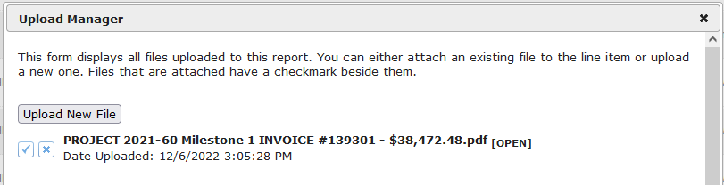
Uploading Expenditure
Uploading Documentation to Support Expenditure
County will upload documentation to support each expenditure
Naming Convention: PEMA suggests corresponding title relating to expenditure for easier review
Check Box: Ensure the checkbox is selected with each associated upload

Slide 23
New Financial Reporting System
Coming July 2023
A new Financial Portal will replace the Webtool
Quarterly Progress Report (QPR) will incorporate Schedule B information
PEMA will set-up instruction sessions in early 2023 to train on the transition
Training on
Financial Portal
will be announced
in early 2023

Slide 24


Quarterly Progress Report (QPR)
Coming July 2023
A new Financial Portal will replace the Webtool
PEMA will set-up instruction sessions in early 2023 to train on the transition
Quarterly Progress Report (QRP) will incorporate Schedule B information
15% Funds – Quarterly Progress Report (QPR) Requirement: For counties that have an open grant project, a QPR must be submitted by the county each quarter until the project is closed. If a county has an open statewide interconnectivity project, the QPR will serve many important functions and will be the only method to perform: Reporting project progress Requesting milestone payments Reporting grant expenses Closing out a project Note: PSAPs will only be able to report project expenditures or request payments on a quarterly basis by using the QPR. Project progress reported on the QPR will assist with evaluating payment requests. | Requirement of
 | 83% Fund | 15% Fund
 | NO | YES

Slide 25
ALL EXPENSES FOR CY 2022,
INCLUDING THE LAST MILESTONE,
MUST BE RECORDED AND PAYMENTS REQUESTED
IN CY 2022
Important Change
ALL EXPENSES FOR CY 2022,
INCLUDING THE LAST MILESTONE,
MUST BE RECORDED AND PAYMENTS REQUESTED
IN CY 2022
How to handle projects at year end:
Step 1: Ensure all project costs incurred in 2022 are reported on Schedule B.
Step 2: If unearned revenue, PEMA/County adjust revenue to match expenditures.
Step 3: Unearned revenue reported as grant revenue on ensuing Combined Report.

Slide 26
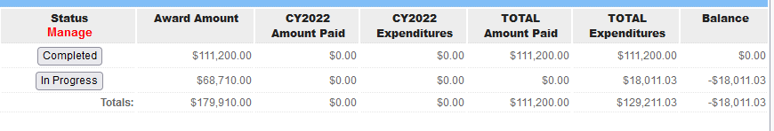
Milestone Negative Balance
Milestone Negative Balance
PEMA will communicate with the County on the negative balance in the last month of the 4th quarter
Partial payment will be disbursed, if no additional expenditures are uploaded in CY2022.
This procedure includes the last Milestone of a Project

Slide 27
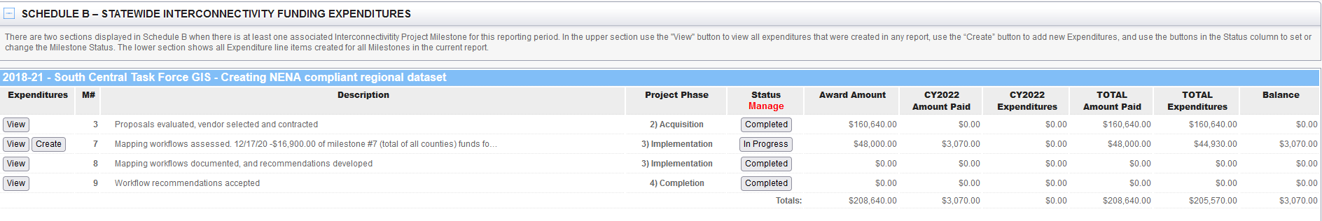
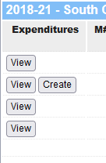
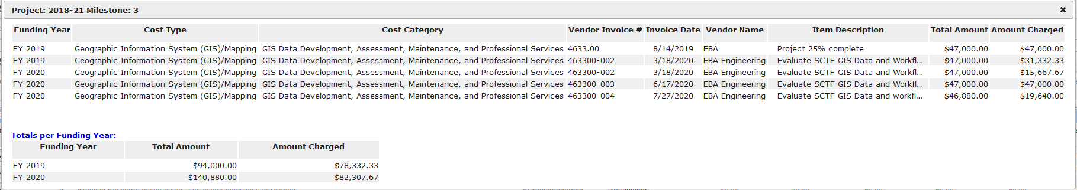
Project View Functionality

Slide 28
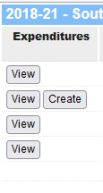
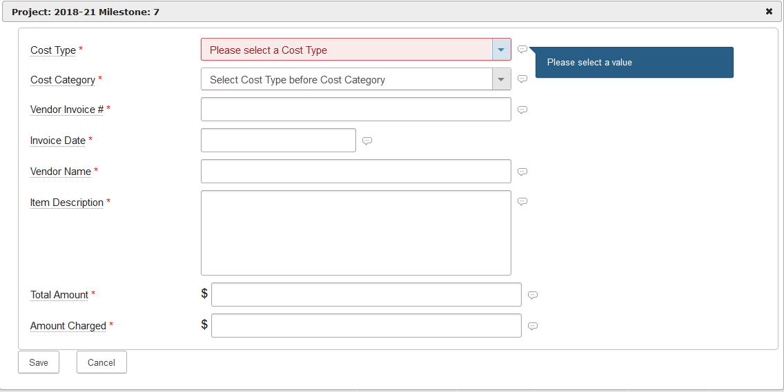
Project Create Function

Slide 29
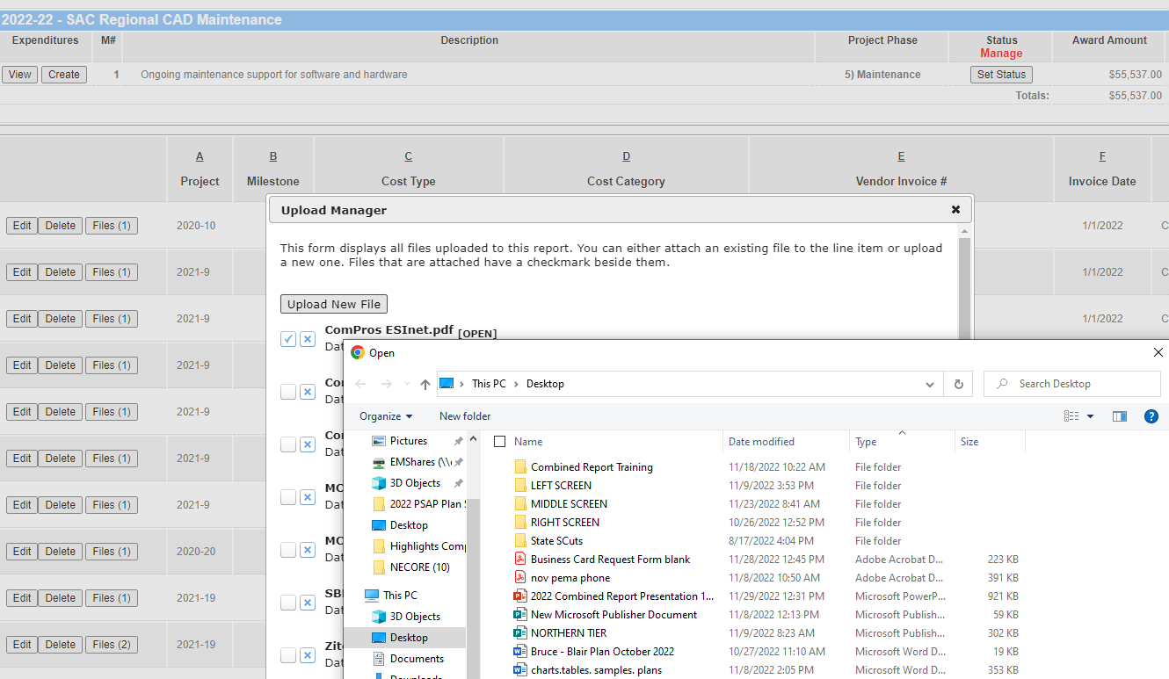
Schedule B: Uploading a File
(Must be done in current year)
After creating the expenditure, the line will appear on the bottom.
2. Click on files (0).
3.Click the upload new file or select an already uploaded file.
4.Upload the file if not there - name it so it is easy to find.

Slide 30
Helpful Reminders
Helpful Reminders of Schedule B Grants/Projects
County should monitor Period of Performance (POP).
Disbursement of Funds can not occur past the POP end date.
County should request Grant Extension, if project will extend beyond the POP.
PEMA is coordinating Grant Extensions to either June 30 or December 31 of a CY.
Grant Extension is needed if a Milestone Award Amount was not disbursed.
Grant expires in 5 years of the POP. This relates only to Milestone funds not disbursed.
Example: 2017 Projects will expire in CY2023, based on the POP.

Slide 31
Section 3: Schedule B Summary
Statewide Interconnectivity Grant Awards
Project information (Milestones, Award Amount, Amount Paid) is pre-populated.
Project balance can NOT be negative
PSAP’s responsibility:
Report project costs in a timely manner.
Update project status. Do not mark project compete unless it is complete.
Invoices are required for all expenditures in Schedule B
Report in the correct project, milestone, and appropriate year
Upload invoice for expenditure and be sure to mark the correct box attaching the invoice to the expenditure.
Do not enter any data for 2023 into Schedule B.
Request advance payments or reimbursements.
Notify PEMA of project completion.

Slide 32

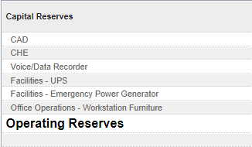
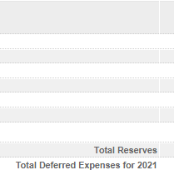
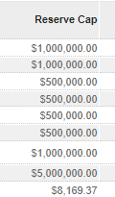
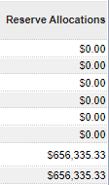

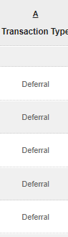
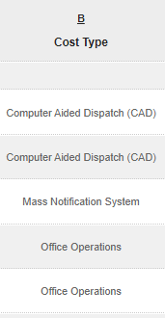
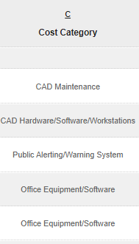
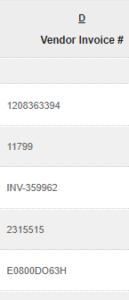

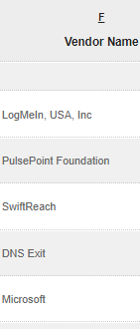
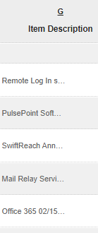
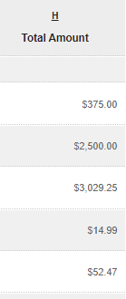
Section 4: Schedule C
Reserves and Deferrals
Summary of Reserve Cap and Allocation totals
Summary of Deferrals

Slide 33

Section 4: Reserves and Deferrals
Summary of Reserve Cap and Allocation totals
Summary of Reserve Cap and Allocation totals
Top Section
Top Section
Summary of Deferrals
Lower Section

Slide 34
Uses of Schedule C
‘Schedule C’ is Used to:
Summary of Reserve Cap and Allocation totals
Allocate 9-1-1 surcharge revenue balance to capital / operating reserves
Summary of Deferrals
Report deferred expenditures for the 2023 Annual Report

Slide 35
Reserve Cap and Allocation Totals:
Clarifications
Reserve Cap and Allocation Totals
Reserves show remaining 9-1-1 funds are dedicated to a future purpose.
Allocations to reserves do not designate PEMA’s approval of a future project or agreement the cost is eligible.
Reserves reported on 2022 report are carried forward to the 2023 annual report.
Schedule C must be populated and maintained each year.
Clarifications/Tips

Slide 36
Capital and Operating Reserve Guidelines
A county may allocate available amounts from their 83% funds balance to capital or operating reserves; showing these funds are dedicated to a future purpose.
Reserves would only apply to formula-based funding balances.
Allocations to reserves must not exceed the Reserve Cap.
A county must maintain an accurate reserve balance.
Clarifications/Tips

Slide 37
Deferred Expenditures Guidelines
Summary of Deferrals
Schedule C. Should also be used to report deferred expenditures for 2022.
Cost incurred. A deferred expense is a cost already incurred but has not yet been consumed or used.
Invoices Uploading. Must be uploaded and selected for both Schedule A and Schedule C, if applicable.
Populate in Schedule A. Deferred expenses reported on Schedule C of the 2022 Combined Report will automatically populate Schedule A on the 2023 Annual Report.

Slide 38
Example of a Deferred Expense
  County executes an annual maintenance contract from June 1, 2022 – May 31, 2023:
Costs for June 2022 – December 2022 reported on Schedule A of 2022 Combined Report.
SCHEDULE A EXAMPLE:
Cost Type | Cost Category | Invoice# | Vendor Name | Item Description | Invoice Date | Amount Of Invoice | Amount Charged
Computer Aided Dispatch (CAD) | CAD Maintenance | 276604 | Central Square | CAD Maintenance, Term: 6/1/22 - 5/31/23. 7 months $35,934.55 belongs to 2022. The 5-month balance $25,667.55 belongs to 2023 & is entered into schedule C. | 6/1/2022 | $61,602.10 | $35,934.55
Costs for January 2023 – May 2023 are to be reported on Schedule C of the 2022 Combined Report as a deferral. This will automatically be populated in the 2023 Annual Report Schedule A.
CORRESPONDING SCHEDULE C EXAMPLE:
Transaction Type | Cost Type | Cost Category | Invoice# | Invoice Date | Vendor Name | Item Description | Total Amount
Deferral | Computer Aided Dispatch (CAD) | CAD Maintenance | 276604 | 6/1/2022 | Central Square | CAD Maintenance, Term: 1/1/2023-5/31/2023. Deferred from schedule A. | $25,667.55

Slide 39
Section 5: Annual Report
Annual Report
Used to generate the Annual Report for the General Assembly
This is CRITICAL
PSAP’s Responsibility
Provide:
Other Activity - “Other Revenue” & “Other Expenditures”
2022 call volume/CAD numbers with supporting documentation
Signature of Controller, Senior Fiscal Officer, etc.

Slide 40
Section 5: Annual Report
PSAP’s Responsibility
This is CRITICAL
Provide:
Other Activity - “Other Revenue” & “Other Expenditures”
2022 call volume/CAD numbers with supporting documentation
Signature of Controller, Senior Fiscal Officer, etc.
Other Revenue
Only include 9-1-1 derived revenues, such as dispatching or tower lease revenue
Do NOT report contributions by the General Fund
Other revenue is not required to match other expenditures
Other Expenditures
Include all reasonable costs of the 9-1-1 program not funded by Formula Fund revenue.
Includes expenditures funded by other funds/programs, any portion of 9 -1-1 related debt service not charged to Act 12, and,
Ineligible costs of the 9-1-1 Program.

Slide 41
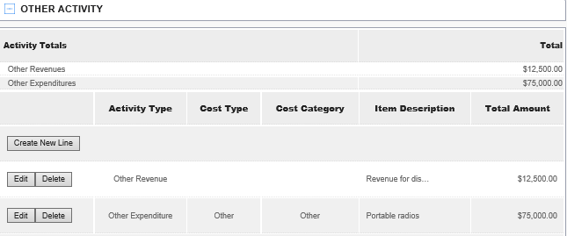
Other Activity Section
Example Other Activity Section:

Slide 42
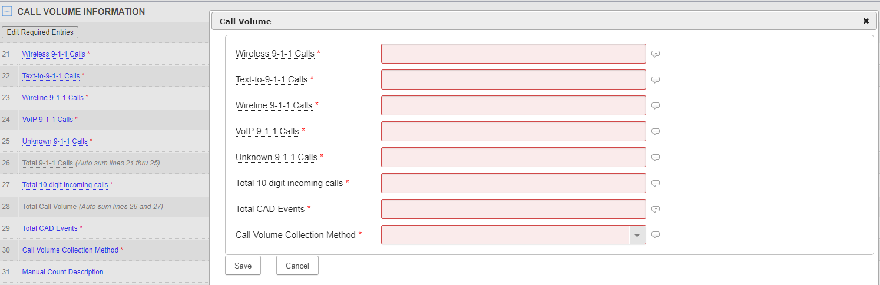
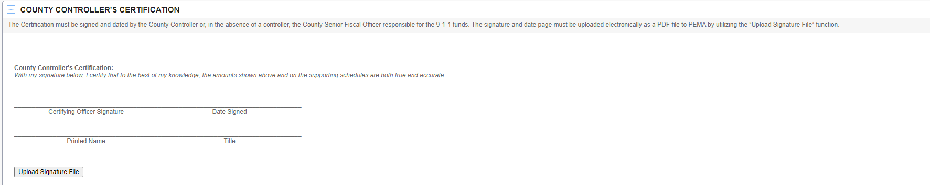
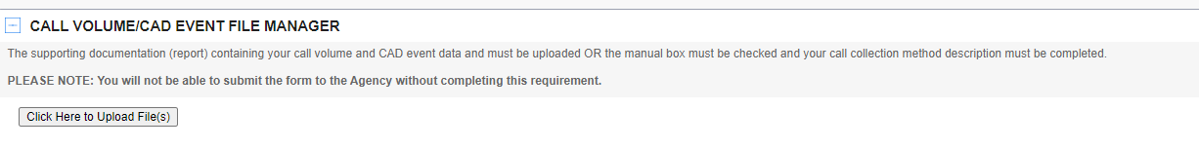
Call Volume, CAD Events, Certification

Slide 43
PEMA Contact information
PEMA 911 Administration Team
Bruce Butler bbutler@pa.gov 717-651-2036
Mark Rothermel marotherme@pa.gov 717-651-2158
Brian Eichenlaub briaeichen@pa.gov 717-346-3136
Zil Jaigirdar zjaigirdar@pa.gov 717-346-3140
TO GAIN ACCESS TO THE WEBTOOL, CONTACT PEMA
Pennsylvania Emergency Management
Agency
1310 Elmerton Avenue
Harrisburg, Pennsylvania 17110
www.PEMA.pa.gov

Slide 44
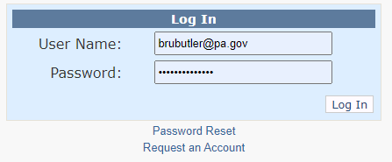
PEMA Contact Information
How do I request an account?
To request an account, click on the Request an Account link found under the log in form on the home page. After you submit the request, you will receive a confirmation email with your username. Once your account is approved your account it will be activated, and you will receive a confirmation email from the account administrator.
https://www.pemawebtools.state.pa.us

Slide 45
Pennsylvania Emergency
Management Agency
2023 911 Program Guidance Overview

